Slide 1
Asynchronous Programming in C#
IN710 OOSD 2017
Session 13.2
Notes:
Recently added language features to simplify concurrent processing

Slide 2
Problems with Threads
High processing overhead
Don’t permit exception handling
Difficult to specify “what should happen after”
Notes:
In addition to concerns about thread safety....
High processing overhead creating and destroying threads
No point wrapping your threaded code in a try-catch, the catch will run on the original thread, not the new one
No “onComplete” event. Can handle clumsily with Join, but this is not satisfactory.
So, C# (5.0?) introduced a class that wraps the low-level thread and solves some of these problems

Slide 3
Tasks
Accepts the “to be threaded” code as a delegate.
Allow normal exception handling
Managed by a Task Scheduler module in the .NET framework that optimises for efficiency.
Runs off the Thread Pool, a set of pre-made reusable threads.
Can be bound to a callback for “on completion”.
Notes:
Allows normal exception handling
Runs off thread pool (set of pre-made reusable threads; save resources) automatically
Allows callbacks (instead of just “join”)
Managed by Task Scheduler for efficiency
A Task encapsulates code that should be run asynchronously (i.e. without blocking).
A method on the main thread launches a Task, but can continue its own execution while the task completes.
A callback can be bound to the task for its “onComplete” event.

Slide 4
Tasks
A Task’s bound code can be launched like a normal method call.
If appropriate, the Task is run on a separate thread taken from the Thread Pool
Execution of the launching method’s code continues without waiting for the Task to complete.
When the Task completes, its callback (if specified) is automatically queued up to run.
Notes:
The Task Schedule decides when it is appropriate, and we will see what it bases that decision on a bit later.

Slide 5
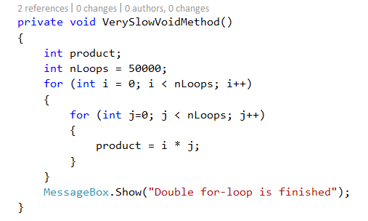
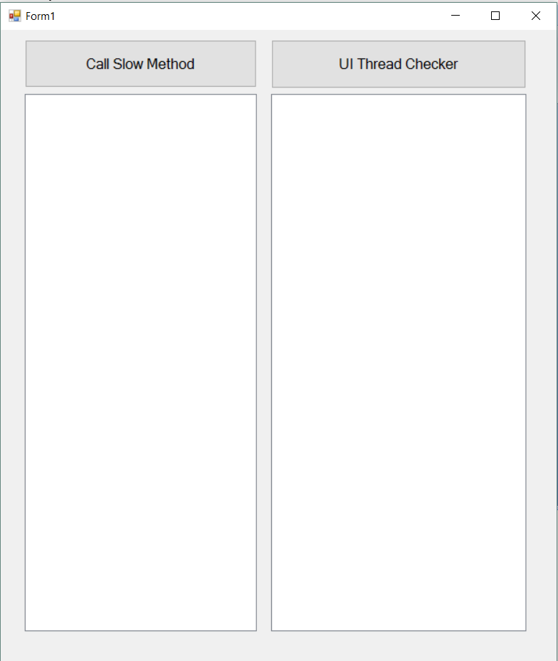
Example
Notes:
This double-for takes about 5 seconds to run.

Slide 6
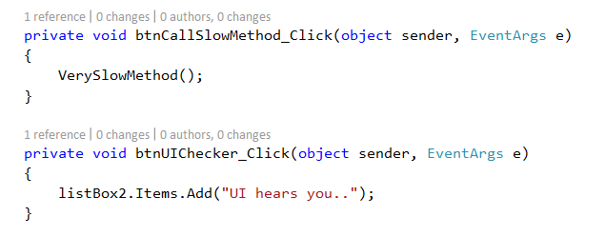
Example
Notes:
I have this program, with two buttons.
The top one calls our slow method, the bottom one writes to the listbox.

Slide 7
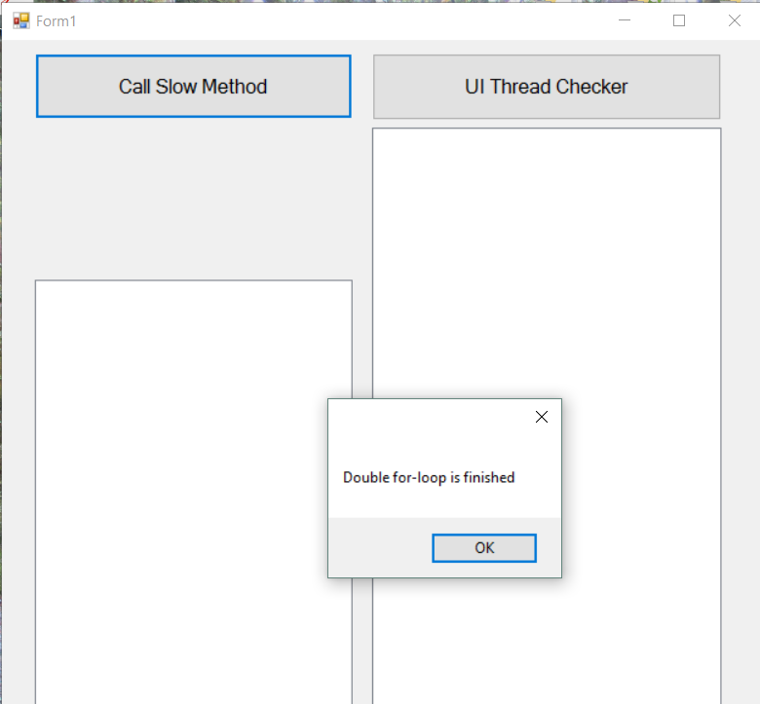
Example
Notes:
Here I have clicked the button on the left, starting verySlowMethod.
During that time, I have clicked on the UI checker several times, but it is dead.
It doesn’t highlight and it doesn’t execute its code.
The UI thread is busy running that double-for, so it isn’t listening for the mouse (technically, it isn’t monitoring the message buffer where the mouse clicks are being placed by the operating system.)
To overcome this, we can wrap our slow method in a Task object, so that it runs on a separate thread.
Like this

Slide 8
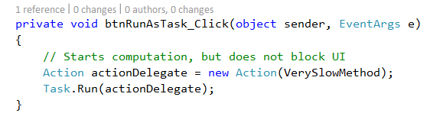
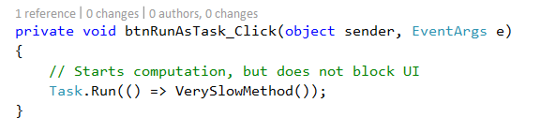
Running a Task
Notes:
Action is a system delegate type, specifically for a void/void method.
It is like Func (remember that?) but for voids.
This code is more commonly written using the shorthand shown...
They are equivalent.
Setting up Task.Run is equivalent to making a Thread with VerySlowMethod and calling Start().
When we click this button, the task starts, but the main thread continues without waiting for it to complete, so the button is live.

Slide 9
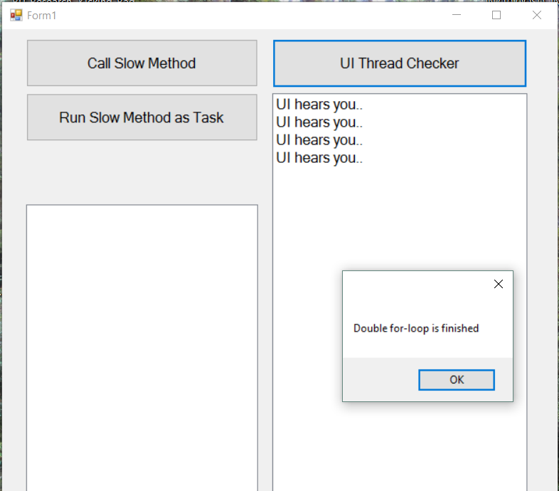
Example

Slide 10
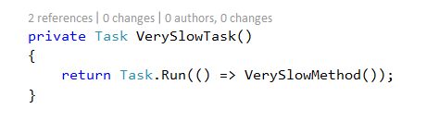
Task Objects
Notes:
A call to Task.Run returns a Task object, which you can capture and use in various ways.
For example, you can read the Status property or, as we will see later, you can attach a callback.
For greater flexibility, you more often see the Task.Run wrapped into a function that returns Task, like this.
This is also an important part of the async/await architecture, which we will see later.

Slide 11
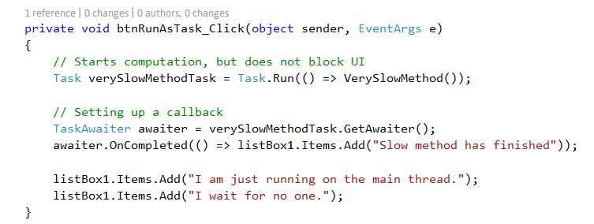
Adding a Callback
Notes:
Walkthrough
We launch the slowMethod wrapped as a Task
(We haven’t used it here, but that Task object has various exposed properties like Status that one could look at.)
It goes off and starts doing its work
The button click handler continues
In the next two lines, it binds a callback for what should happen when that slow method finishes.
Then it just continues on executing. In this case, it writes a couple of lines to its listbox, which it can do no problem, because it is on the main thread.
What does this output?
(We see the 2nd and 3rd Add before the first one...)

Slide 12
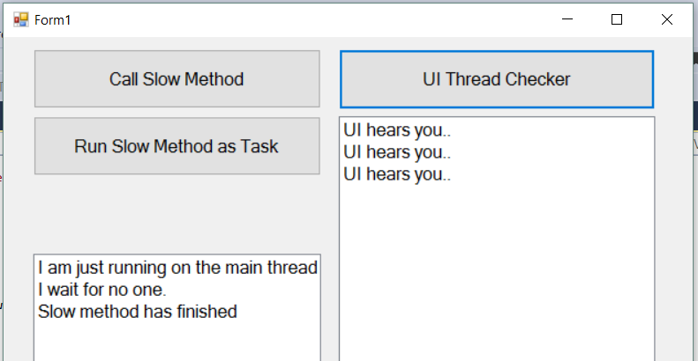
Adding a Callback
Notes:
...and the UI is live while you are waiting for that 3rd line
Note that it doesn’t hurt anything if the Task actually finishes before the binding, it just executes as normal.
So for awhile, this was “better than Threads”. But as people needed to use it more, they made the syntax simpler.

Slide 13
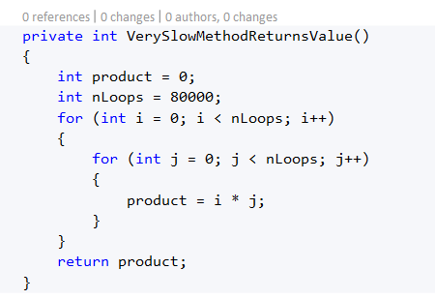
Task<resultType>
Notes:
Here, we have a method that returns a value
We can run it as a Task like this, but we can’t get the return value.
Remember that before, with our void method Task.Run returned a Task object -- that computational thing that we can check Status and add callback?
When you give Task.Run a method that returns a value, you get a descendent of Task Task<resultType>
Like this...

Slide 14

Task<resultType>
Notes:
Note that this code will actually block the UI thread, because execution moves onto the next statement but the right-hand side of an assignment statement is evaluated first, so it have to wait.
We will see a method later that fixes this, but you can also prevent it with a callback

Slide 15
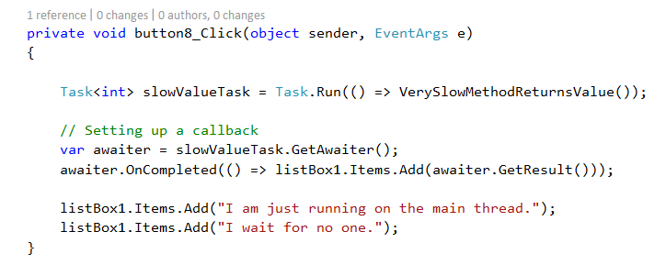
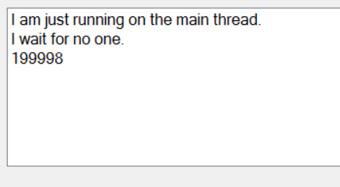
Callbacks with Task<T>
Notes:
See the awaiter.GetResult, which returns the return value of the Task
As before, the 2nd and 3rd line are written before the output of the Task.

Slide 16
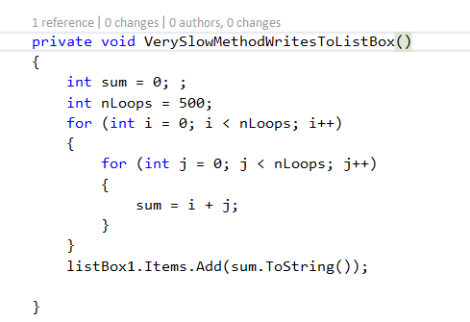
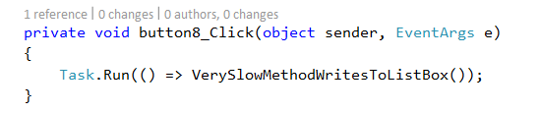
Cross-Threading Issues
Notes:
Imagine I have changed VerySlowMethod to write to the listbox, rather than raise the messagebox.
What will happen when I launch it as a Task?
Well, it will look like nothing happens, actually. Like the method doesn’t even run. But what really happens is that a cross-threading exception will be thrown, on the Task thread, when it tries to write to the listBox.
As you know writing to another thread’s controls is not permitted.
As you know, this can be managed with Invoke.
We will see in a minute that it can also be handled with a new C# concurrency feature, async/await.
Before we see how to do that, though, we need to think a little bit about the kinds of concurrency we might encounter, and to meet async/await

Slide 17
CPU-Bound vs. I/O-Bound Operations
CPU-bound
Processing is blocked by a long computation
IO-Bound
Processing is blocked while waiting on a slow I/O operation
CPU-Bound delays benefit from creation of a separate thread.
I/O-Bound delays do not
Notes:
Our double-for-loop is CPU bound – the CPU is performing instructions
A slow database or http access is I/O Bound. There is nothing for the CPU to do while it waits
You can see that creating another thread to sit and wait for an http call makes no sense.
So for I/O bound operations, there is an alternative approach in newer versions of C#

Slide 18
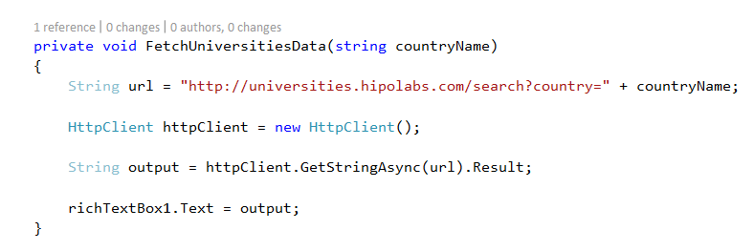
I/O-Bound Computation
Notes:
If called in a button click handler, this blocks the UI thread

Slide 19
await
The keyword await placed before a statement means: “After you launch this statement, don’t pause its execution thread waiting for it to finish.”
await does not start a new thread, it just “frees up” the current thread.
When the “awaited” operation finishes, execution resumes from that point in the code.
Notes:
Using await
Thus await is perfect for I/O bound operations
The thread does not block. Other work that is going on can continue –e.g. The UI will be responsive. If you have animations running they would continue to run. If this was a web server that was handling requests, it would continue to do so.
When the I/O bound operation completes, execution picks up right where it left off, so no awaiters or other callback arrangements are needed.

Slide 20
await
To use await on some code, you must make it “awaitable”.
Tasks are awaitable.
Therefore, we bundle our I/O bound code into a Task or Task<T>
Notes:
You can’t, however await any kind of statement. It has to be one that can be “waited for”.
A statement can be waited for if it bundles itself up into a Task (remember them?)
So, to allow our http call to run efficiently we go....

Slide 21
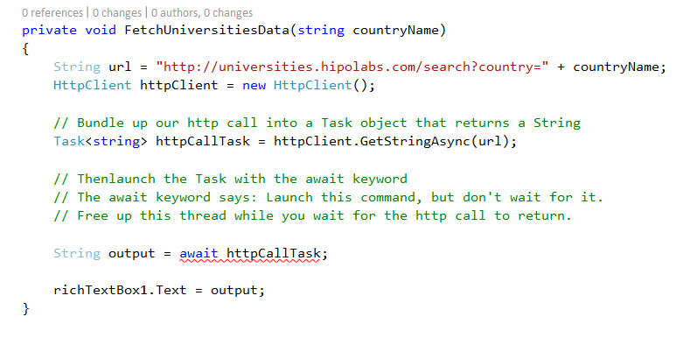
await
Notes:
Ignore the error for just a minute
Here we bundle the http call up as a Task<String> because GetStringAsync returns a string (that’s what the Async in the method name tells us).
Then we launch the task with await.
Note that we don’t have to use the Result property anymore; making it Task<string> produces the same return.
You’ll see that we have a syntax error...

Slide 22
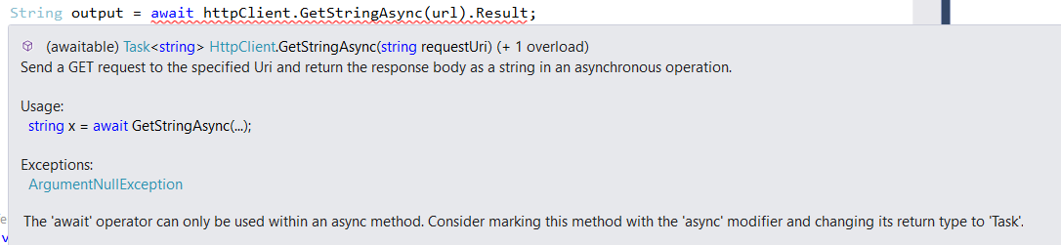
async
Notes:
We are being asked to mark this method with the async keyword and change its type to Task.
The async keyword is purely for the compiler. It “avoids ambiguities” according to the documentation
Sort of like repeating override, it tells the compiler that you really know what you’re doing here.
The “returning Task” part makes the whole method awaitable, so you can chain and nest these calls if needed.
So, we make the requested changes....

Slide 23
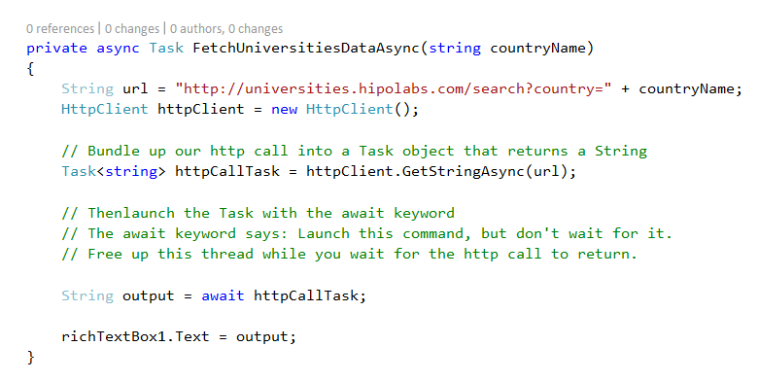
async & await
Notes:
Note also, that we have changed the method name to .....Async
This is conventional
It just tells future users of the method (who might not necessarily have the whole method code) that there is awaiting happening in here.
This should tell you something about HttpClient.GetStringAsync => it’s got some await statements in it, or Task.Run
Now, if we call this method in a button-click, the UI remains responsive during the http access.

Slide 24
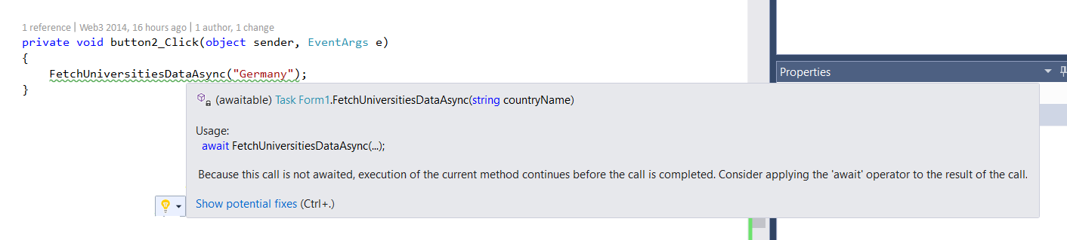
Technical Note
Notes:
When you put this method into the button click handler, you get a compiler warning (not an error) saying effectively “are you sure you don’t want to await this call?”
This happens whenever there is any await statement inside the method – it offers you the opportunity to cascade the awaiting. This is just a compiler weirdness (many would classify it as a bug) and should be ignored.

Slide 25
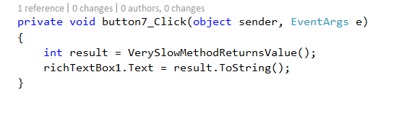
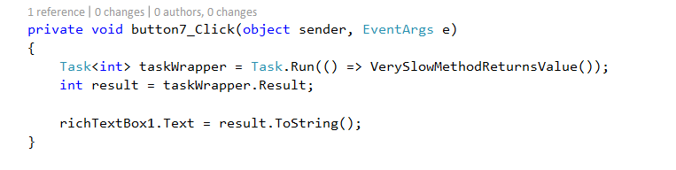
await with CPU-Bound Computation
Notes:
Since await doesn’t create a new thread, it won’t improve performance on CPU bound tasks directly.
But we can force it to by wrapping our CPU-bound code in a Task and awaiting the Task.
The await prevent blocking and the Task wrapper gets you a new Thread.
The synchronous version...
And remember that this version also blocked, because the second statement had to wait for its right-hand to finish.
So how can we get it not to block?
We want to launch taskWrapper and free the main thread while it does its work, then pick up where we left off => that’s exactly how await works.

Slide 26
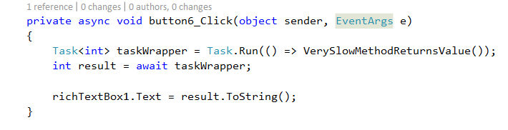
await with CPU-Bound Computation
Notes:
This does not block, and there is no cross-threading problem
Note that we again don’t say “Result”, because await means “await the result”
Note that we mark the button click handler method as async, but don’t change its return type to Task, because we don’t intend the ever nest it.

Slide 27
Syntactic Simplification
Note that there are syntactic options for async & await that eliminate the need to explicitly create the Task object.
Left as an exercise.
Notes:
There are some shortcuts that require less typing, but it can start to get very confusing who is actually being paused and who isn’t, so I suggest that you work with the full syntax until you feel very comfortable with async & await before moving to the shortcuts.

